Slide 1

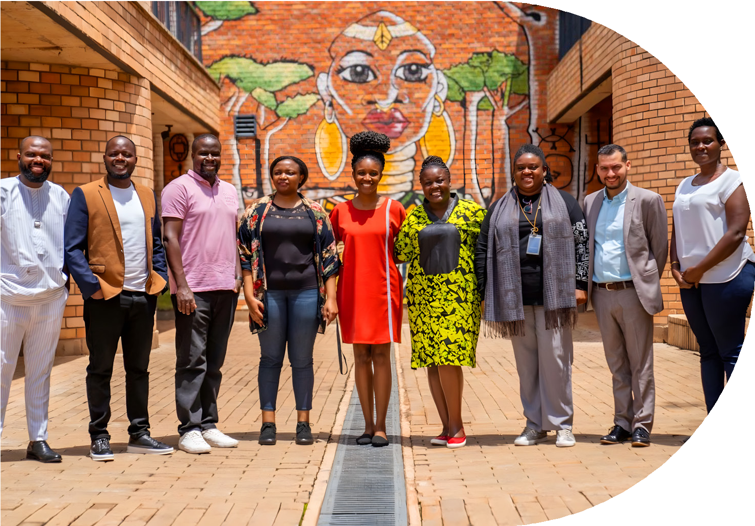
VALUE PROPOSITION
InHive Global

Slide 2


13 Years of Impact & Reach
About Inhive Global
One of the reasons we support networks is because of the amplifier effect. By working closely with a small number individuals to strengthen their network strategies and approaches, we can help them better reach and impact thousands or millions - dramatically changing lives while also contributing to broader systemic change.
Specialist Network Builders
InHive Global specialises in network building with marginalised and economically disadvantaged young people. Using an evidence-based approach into network-building, and considering best practices from over 30 countries, inHive has helped to build and develop networks that have served over 180,000 young people, across 22 countries, including Pakistan, UK, Australia, Ghana and Rwanda.
Our unique technical expertise, we are also passionate about building a more sustainable and equitable future. We believe that Networks can be a force for good, and we are committed to using our skills and resources to drive positive change in the world.rough direct partnerships and collaborators, as well as establishing a global platform (Nexus), inHive acts a strong inclusive facilitator connecting a broad global reach of civil society organizations, alumni networks, institutions, academia, philanthropists, movements, and activists who collectively work to advance the needs of youth across the globe.
Organizations Directly Supported
Individuals Trained & Coached
People These Networks Reach

Slide 3



Networks help solve Global Challenges
As network building specialists we believe that accessing high-quality networks and relatable role models supports better and more equitable life outcomes. At an individual level, networks provide the social capital needed to find jobs, mentorship and investment for a business idea. At global level, a network can help solve the challenges that young people face today, from climate change to socio-economic polarisation, by understanding that it is not one organisation, government, or institution that can change a whole system but working collectively with young people.
Our Mission
To facilitate and enable access to transformative networks and relatable role models for millions of young people to support better and more equitable life outcomes.
Our Values
We aim to connect, inspire, and support young people around the world, and to foster a culture of empathy, inclusivity, and purpose-driven action.
Our Vision
Inequality is reduced over time as a result of enhanced life opportunities for youth and other marginalized
Our Theory of Change
Focuses on achieving better life outcomes for youth across the globe via inspiration, guidance and opportunities through purpose-driven transformative networks. InHive has honed this approach for local relevance for low-resource communities and some of the most marginalized youth.

Slide 4
How networks can help young people to thrive:
1
Mentorship networks:
Young people benefit from having mentors who can guide them, provide advice, and share their experiences to help them navigate through challenges. Mentorship networks can be formed through various channels such as schools, community centers, or professional associations.
2
Peer networks:
Young people also benefit from connecting with their peers who share similar interests, passions, and experiences. Peer networks provide a sense of belonging, support, and encouragement, which can help young people to develop their skills, confidence, and resilience.
3
Community networks:
Young people need to be connected to their communities to understand their cultural backgrounds, traditions, and values.
Community networks can provide opportunities for young people to engage in community service, volunteer work, or cultural events, which can broaden their perspectives and build their social capital.
4
Technology networks:
Technology can be a powerful tool to connect young people with each other and with resources that can help them to thrive. Technology networks can include social media platforms, online communities, or e-learning platforms that provide access to educational resources, training programs, or career opportunities.

Slide 5

Our Unique Approach and Methodology
No matter where your network or community is at, we can help it reach its next stage
Network DESIGN
Establish network roles
Adopt participatory decision
structures
Set up technology & infrastructure Determine resource budgets
Network ACTIVITIES
Boost engagement and diverse offerings
Build community & trust Foster learning & exchange Spark collective action
InHive has developed its own unique proven methodology Networks Assessment Matrix to help strengthen and build sustainable networks using the following approach.
Specific Approach and Methodology
To build a networkwe believe there needs to be four core elements:
the vision and purpose
the structures and leadership
the activities and mobilisation
the engagement and communications
inHive will assess and implement all of these elements in a bespoke way using our Networks Assessment Matrix (NAM) and tailored support.
How do we do it?
Network STRUCTURES
Establish network roles
Adopt participatory decision
structures
Set up technology & infrastructure Determine resource budgets
Network IMPACT
Develop a theory of change Outline key impact indicators Introduce participatory collection
methods
Engage members in reﬂection and
analysis

Slide 6


Our Target Audience
Systєm infiuєncєrs and investors (funders, policy makers, policy advisors)
We are convening and steering global networks to drive collective increase in awareness, impact and investment in alumni networks.
Organisations and institutions (alumni practitioners within school networks, youth organisations and other)
We are driving thought leadership and discussion around alumni networks to unlock further partnerships, funding and impact.
Alumni network leaders and partners
We are building and strengthening alumni networks that support marginalised vouth and have increased the number of young people directly supported through our work.

Slide 7




Our services
Network Design, Development, and Management
Network design, assessment, strengthening, and ongoing network management across sectors
One-to-one technical assistance and tailored support for partner organisations
Technical Assistance and Capacity Building
Development of customised strategies and workplans aligned to partner objectives to foster network development and engagement
Partnerships and Collective Actions
Convening and facilitation of multi-stakeholder partnerships and collective action
Digital Platform and Tools
Hosting and enabling networks on the NEXUS global platform, including tools, resources, and peer learning
Application of evidence-based tools
for network development
and impact measurement (including the Network Assessment Matrix – NAM)
Programme and Fund Management
Programme and project management, including coordination, implementation, reporting, and fund disbursement as a fiscal agent

Slide 8

Why are we different?
We provide our clients and partners with the tools and support they need to thrive in a rapidly changing world. We pride ourselves on our ability to deliver customized solutions that are tailored to our clients' unique needs and goals, and we are dedicated to providing the highest level of customer service and support.
Capacity building
Evidence and research tools support resilience and sustainability of networks for youth- centred social change
Thought leadership
Amplifying the new narrative "power of networks'
Sector building
Share experience and best practice, new partnerships and collaborations
Stakeholder Connectivity/Reach
Nexus membeship for network activism and leadership around the globe

Slide 9



Building Alumni Communities and Impact Networks (BAC-IN) 2023-2026: $1.7 M
The Building Alumni Capacity and Institutional Networks (BAC-IN) project, implemented by inHive Global with support from the Mastercard Foundation Scholars Program, strengthens the ability of Scholars Program partner institutions to design, implement, and sustain inclusive and institutionally embedded alumni engagement systems. This invaluable partnership furthers the purpose of the Mastercard Foundation Scholars Program through strengthening the capacity of 15 African scholar partner universities (public and private) to build and improve alumni networks’ structures, activities, engagement, and collaboration.
The Consortium includes expert organizations with Africa-based presence: Education Sub Saharan Africa (ESSA); Digital Rights Frontlines (DRF) Enlightening and Empowering People with Disabilities-Africa (EEPD-A)
InHive shares the vision with Mastercard Foundation that programmes such as BAC-IN can help reduce inequalities among young people through systemic change. By building capacity and nurturing leadership skills, we recognise how the immense potential of alumni networks can contribute to positive and lasting transformations in young people’s lives and communities.
BAC-IN Programme Support
Since 2023, BAC-IN has equipped universities and graduates with the skills and systems needed to build strong, inclusive, and sustainable alumni networks. This includes:
Institutional strengthening through developing alumni engagement strategies, databases, and governance frameworks and capacity building.
Alumni leadership – building confidence and leadership skills through workshops, storytelling, and mentoring.
Inclusivity – intentionally engaging women, refugees, and persons with disabilities in leadership roles and through capacity building
Collaboration – fostering peer learning, joint workshops, and cross-institutional exchanges for alumni and university staff.

Slide 10

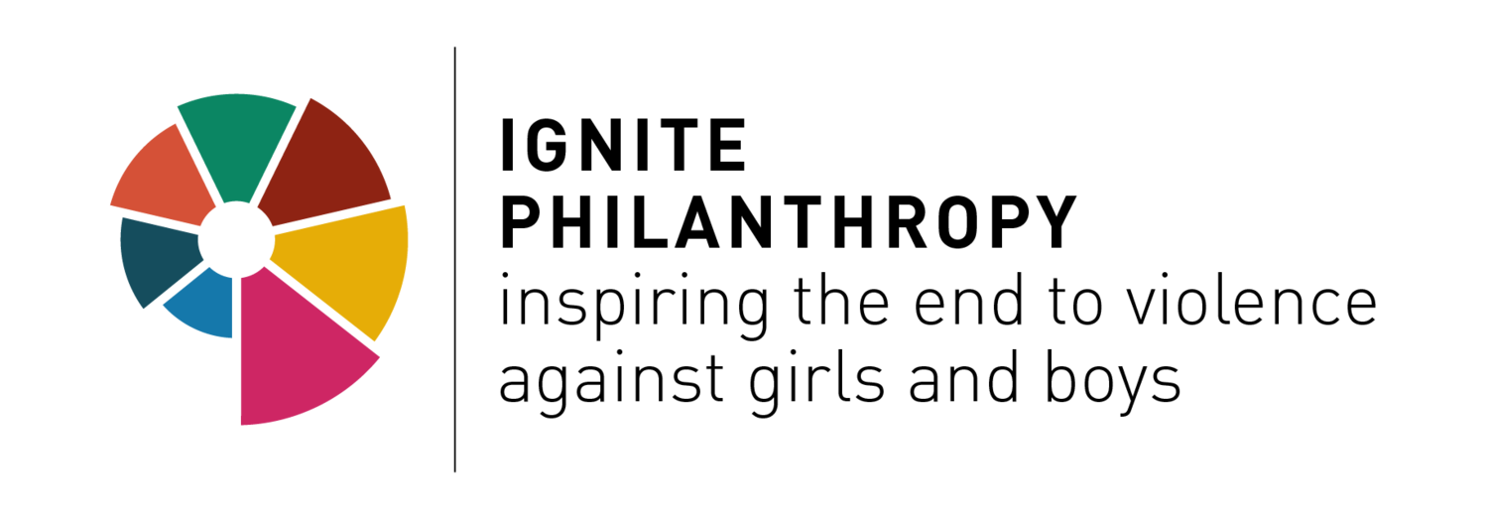





















Our Partners
GARFIELD FOUNDATION
_{FAWE} Forum for African Women Educationalists Forum des éducatrices africaines

Slide 11
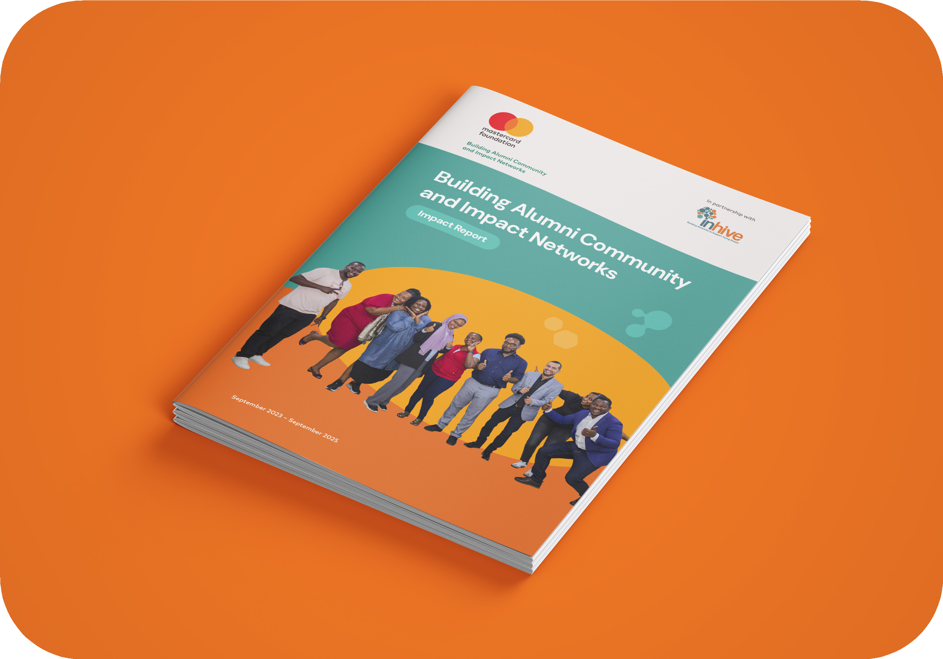
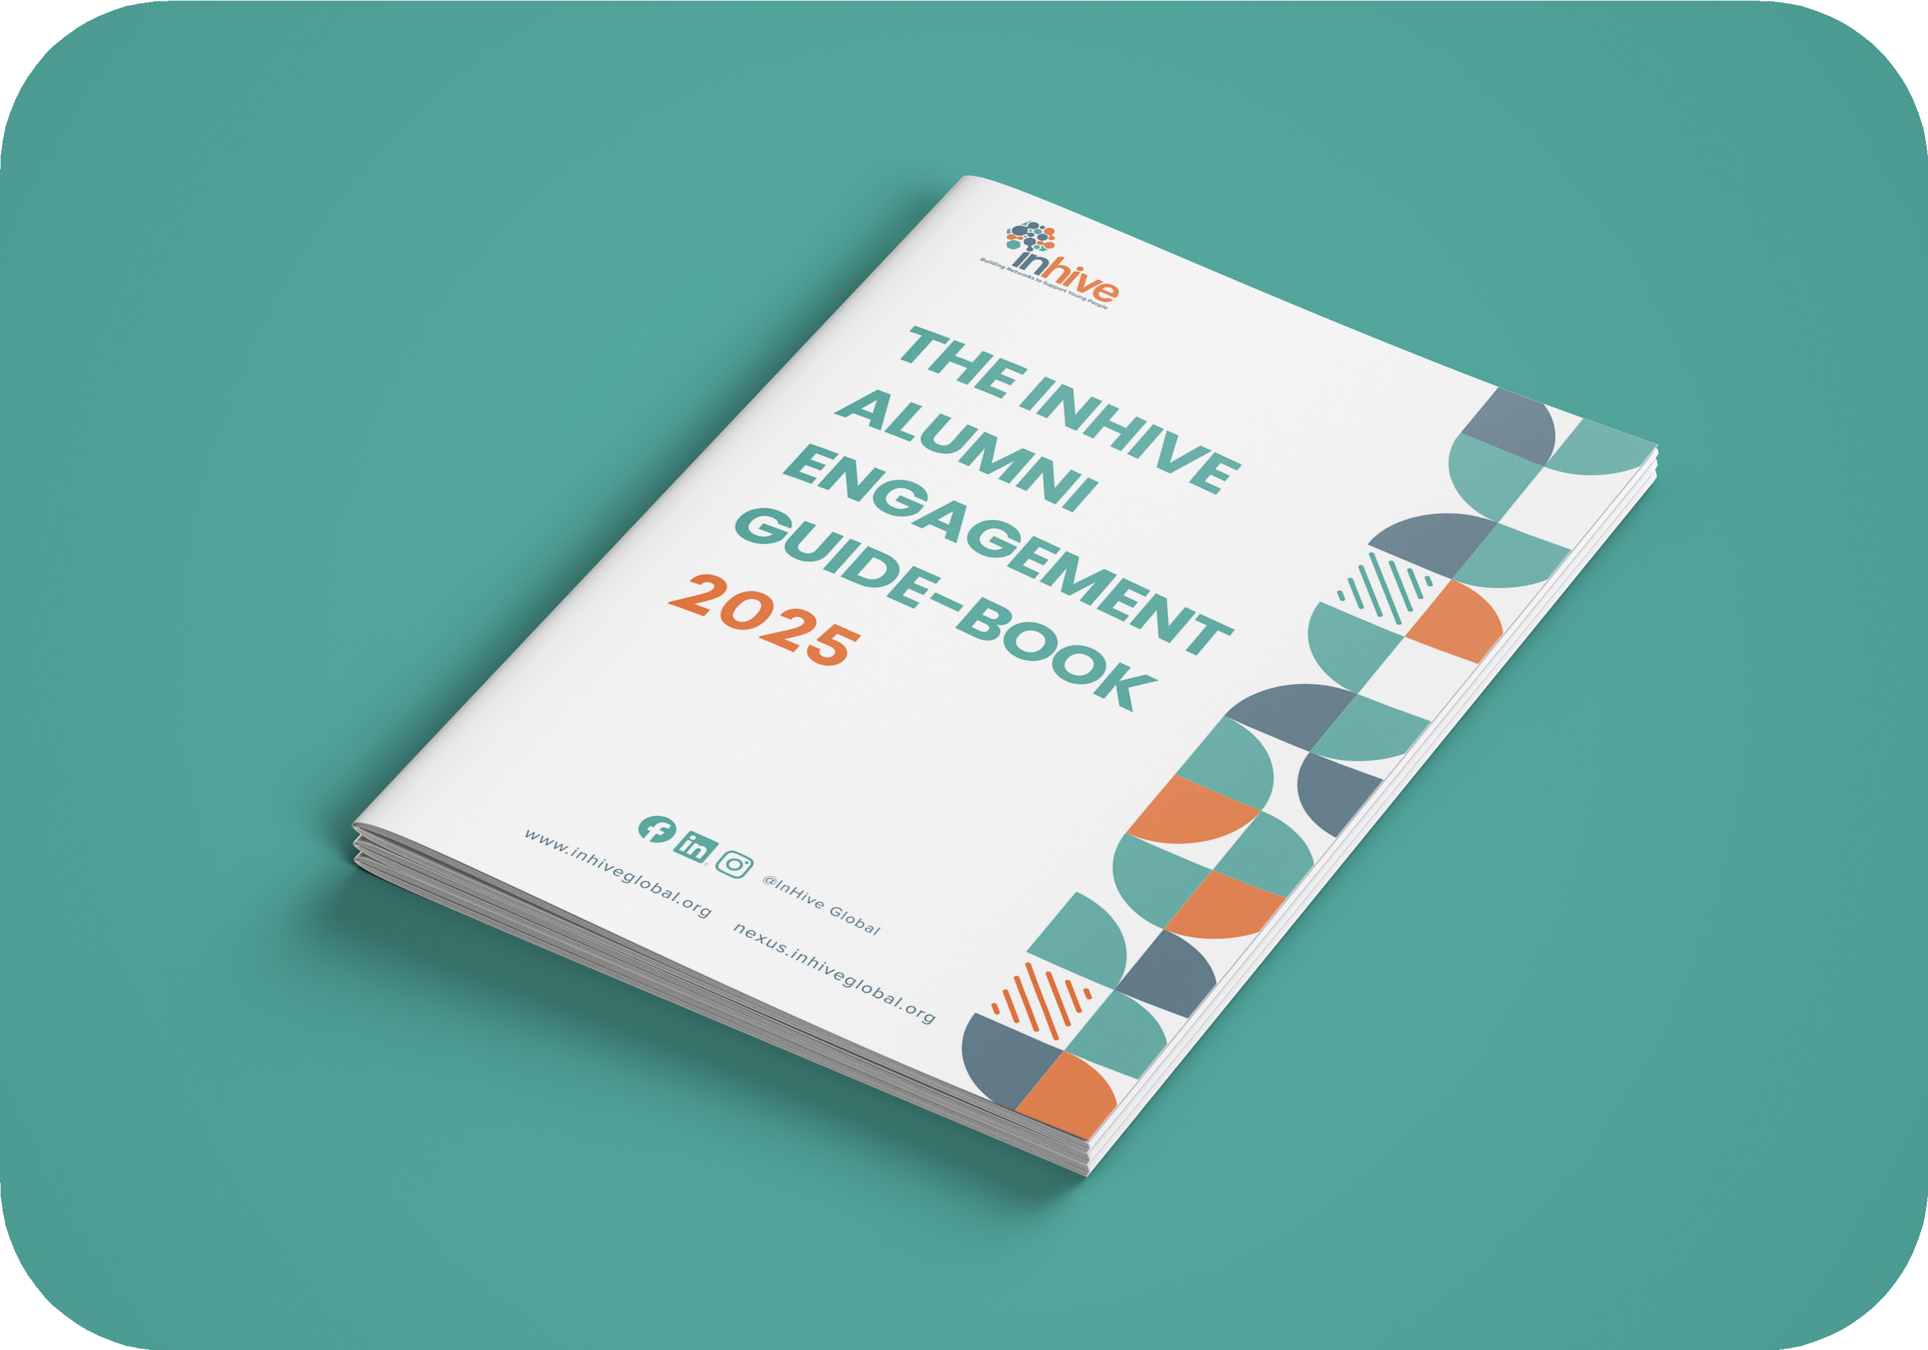

Resources
Building Alumni Community and Impact Networks Impact Report
The InHive Alumni Engagement Guide-Book 2025

Slide 12
Project examples

Slide 13

Please see below examples of how our services support network building with impact, in achieving better life outcomes for young people.
Using evidence-based research in building youth networks and movements! | Partners
A cross-country study of school alumni networks formed the foundation for our approach towards networks and youth. We have also developed a best practice guide for Programmatic Alumni Network building. Here you can browse some of the research studies we have produced focused on youth networks.! | An in-depth feasibility study across nine countries that demonstrates the universal value of alumni networks in schools and shares examples of ad hoc best practice around the world.
Analysis of independent youth-focused networks. | Teach First network in the UK, the Mastercard Foundation’sglobal alumni network; Jacobs Foundation global network for childhood education.
Alumni Impact Study (2020 – 2022) report. A study on the impact of alumni networks on educators in secondary schools with data from the UK, Pakistan, Australia and Kenya. | inHive collaborated on with 4 other organisations (FFK, FF UK, CARE Pakistan and Ourschool Australia)
Network Tools/Resources | Access
Developed anetworks playbook, which is accessible on our website. | Free resource containing learnings that emerged from a participatory learning journey between practitioners and funders who develop networks for social impact.
Advisory Consultancy | Partners
Supported the design and set up of 6 national/regional chapters of the Foundation’s global alumni network of networks. The network brought together former participants of the Foundation’s diverse programmes in service of harnessing the transformative leadership of young people and the creation of dignified and fulfilling work for 30 million youth. Based on an inHive’s feasibility study that included in-person and online focus groups and interviews, as well as a global survey of young people, we made recommendations to the Foundation on a national chapter structure. A summary report for the Mastercard Foundation can be found here. | The Mastercard Foundation

Slide 14


Advisory Consultancy | Partners
Documenting Good Practices Worked with FAWE, a regional, pan-African organisation, which focuses on women in education. The organisation, brings together 30+ national member chapters under a regional secretariat. InHive helped assessed the needs of their alumni members and clarifiedthe purpose and vision of the network, as well as its member member communication and engagement strategies. Part of our workplan to achieve this has been the identification of good practices from within the network and facilitating cross- | Forum for African Women Educationalists (FAWE)
DEI and women empowerment: “The Role Model Effect: Increasing Girls’ Participation in Education in Rural Pakistan”. InHive worked with Pakistan Youth Change Advocates (PYCA) implementing a girls’ empowerment project.We mobilized and supported a group of young educated female volunteers to serve as role models for over 3,000 students at their former secondary schools. The project also included setting up alumni networks in these schools to systematically mobilize other alumni as mentors and provide support to the schools and each other. PYCA and inHive co-developed a unique training methodology and curriculum and recruited women from seven school communities in various districts of Pakistan. The alumni networks and the female role models that they mobilized are expected to help shift the perceptions of the importance of girls’ education and enable more girls to complete schooling. The projectgoals included mobilizing policymakers and raising awareness of key education sector stakeholders by sharing the results of the project and story-telling campaigns. We convened various stakeholders to explore the intersections of gender, marriage and exclusion in Pakistan.! | Pakistan Youth Change Advocates (PYCA)
Creating safe spaces and sustainable network models We are using innovative models to strengthen and build upon work already done, to sustain the empowerment of the young volunteers and the alumni structures within their former schools. With support from PYCA and inHive, the volunteers are establishing Talking Circles in their schools. This will especially include students who might be facing challenges in school or at home. While on the one hand meeting in circles will help build community, resolve conﬂict, and learn interactively, on the other hand, this weekly activity will also serve as problem-solving spaces, helping to identify issues and possible actions to make the school environment safer and more nurturing for the students. | Pakistan Youth Change Advocates (PYCA)

Slide 15

Advisory Consultancy | Partners
Network for career changers into teaching Based on inHive’s initial assessment of the Network, Now Teach implemented several key priority recommendations to foster an inclusive and transformative community of Now Teachers. With inHive’s support, this included supporting Now Teachers to articulate Networks’ vision, organizing a Steering Committee to strengthen members’ voice and ownership of the Network’s agenda and developing internal working practices, capacities and mindsets that will enable the Network to become an engaging community of support for its members and a sector-wide social impact actor. | Now Teach
Convening and connecting networks and stakeholders | Convening networks serving youth
Established Global Platform: Nexus Our global platform, Nexus is made up of 120+ members, whose networks collectively reach over 1,000,000 individuals around the globe. Dozens of these network members have a special focus on engaging and serving youth, at the global, regional, and local levels. The Nexus online platform (launched in February 2023) will: Host any resources and toolkits that members share Accommodate a forum where members can discuss chosen topics Connect members directly to one another Display a shared calendar that will show all upcoming events Support online courses for shared learnings Accommodate our Clusters, each with their own feed. | Nexus members include global education-focused networks like Teach for All, WISE, and Big Picture Learning; networks of young leaders and entrepreneurs like The Clinton Foundation, ChangemakerXchange, the Africa Youth Leaders Forum, Columba Leadership Youth Alumni Network; local networks like Nirantar Trust in India, and OurSchool in Australia; and topic-focused youth networks like the Global Interfaith Youth Movement and the Ignite Philanthropy Network to End Violence against Children. CIVICUS is also a member of Nexus.!
Global Covening event In May 2022, we hosted a first-of-its-kind ENACT! festival which engaged over 100 speakers from 30+ countries, reaching over 1,200 people from over 100 countries that work with communities or networks around the globe. | Many of these were youth-oriented networks as well, such as Young UN, Restless Development, Reach for Change, and the International Youth Foundation, to name a few.! inHive itself also actively participates in and collaborates with many global youth-focused networks, such as the Tamarack Institute’s Youth Futures, Global Shapers, Catalyst 2030, the Possibilists, HundrED, IREX, and many other networks that serve youth.

Slide 16
Networks learning journey | Partners
Through initiatives such as the Networks Learning Journey, we also have a small, growing network of philanthropic organizations supporting youth, who not only have their own networks serving youth but also embrace a networks-oriented approach and mindset in their work. InHive ran an inaugural cohort of the Networks Learning Journey in 2021. With 25 organisations – including funders with an aggregated annual spending budget of more than $1 billion – wehosted a cyclical series of co-created learning sessions to share insights on how funders can better support and work with networks. The goal was to shift mindsets and perspectives and spark new investments in networks across the globe. | Partners included the Jacobs Foundation, the IKEA Foundation, Imaginable Futures, the Mastercard Foundation, and Siemens Stiftung.
Ignite Philanthropy Network for Beneficiaries Ignite Philanthropy wanted to create a network for their first 30 beneficiaries to help share best practice, stories of success and be a place for peer learning and power-sharing techniques. inHive created a 12-month learning journey where we helped to lead some exploratory activities, learning as we were doing. We helped train a group of leaders as a steering committee and worked collaboratively with members to create monthly learning spaces. We set up small peer groups, training them on some facilitation techniques, to support them in sharing any problems they are having in their networks and get peer feedback to collaboratively solve them. We then led a collaborative reﬂection exercise to help evaluate the network so far and plan for the next 12-month journey, understanding a network changes as the member’s needs do. This resulted in a member’s charter with a purpose and mission for the network and a plan of activities that will help the members grow and learn in the next year so they can lead their own networks to make changes to support children across the globe. There has already been some impactful stories from the network. | Ignite Philanthropy funds grassroots networks across the globe fighting child sexual violence.
Amplifying the narrative: the power of networks | Case studies and impact stories
We place extra emphasis on collecting and sharing case studies and stories of youth-oriented networks across the globe. As much of the work around networks is difficult to measure and predict, we find stories to be powerful mechanisms to collect best practices, contextualized impact, and signals of change. | You can find our own repository of youth network stories here, as well as our video database documenting network stories from around the globe.!
Innovative multimedia communication channels amongst marginalised youth In developing innovative multimedia communication channels and improved access to information amongst our communities, we launched the first podcast as part of a longer-term series and project IN-MI-NET in July 2022. | IN-MI-NET is a project that seeks to contribute towards shifting many Europeans’ views on the experiences of migration and settlement through a podcast series. The pilot episode is here.

